Slide 1
National symbols of the USA
Made by: Sándor Máté Marozsi

Slide 2
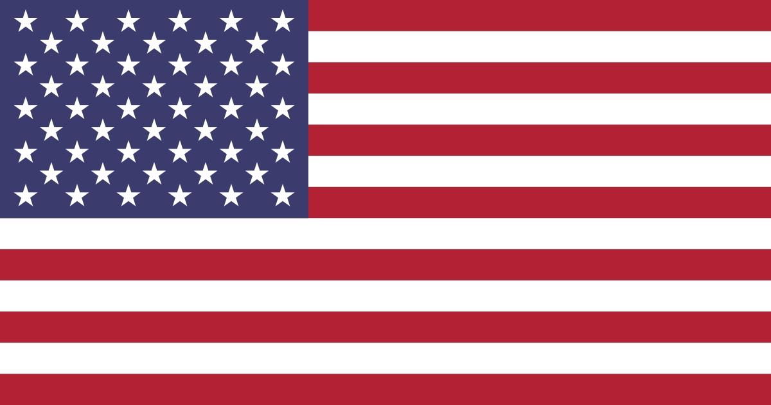
American flag
The flag of the United States has gone by many names and designs since it was first made. The flag represents the land, people, government and ideals of the United States.
The first flag depicted the 13 original colonies, but the top left corner depicted the British flag. After the Declaration of Independence was written, the British flag
was replaced by 13 stripes and 13 stars, which were
the 13 colonies. As more and more states joined the
Union, more stars were added. The 13 original
stripes remain on today's flag, but there are now 50 stars representing the 50 member states.

Slide 3
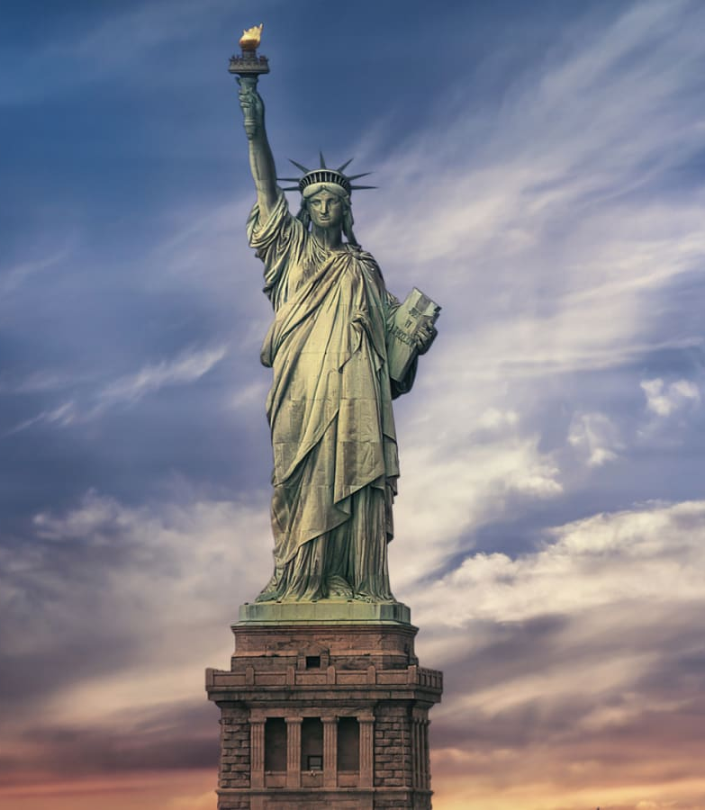
Statue of Liberty
The Statue of Liberty was donated by France to the United States of America as a symbol of friendship and freedom between the two countries
A French sculptor, Fredric Auguste Bartholdi,
designed and selected the site.
The Statue of Liberty is a symbol of freedom for people all over the world. On the crown
the seven spikes, representing the light of freedom.
It is the symbol of freedom on the seven seas and on the seven continents. In his left arm he holds a plaque with the date of the Declaration of Independence.

Slide 4
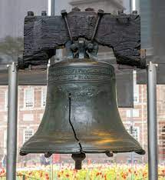
Liberty bell
The Liberty Bell is a treasured memory of America's struggle for independence.
The bell was rung on July 8, 1776, on the 1st day of the Revolution.
It was rung at the first public reading of the Declaration of Independence.
The bell weighs more than 2,080 pounds.
It is located in Philadelphia, just north of Independence Hall. The Liberty Bell has rung for nearly 100 years
many special events. The bell cracked in 1841 and is no longer rung. Although it is struck with a hammer on special days.

Slide 5
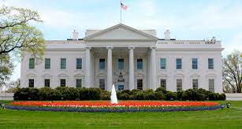
White House
The White House is the home of the President of the United States. Whoever is President lives and works there until someone else becomes President. It is located in Washington. President and Mrs. John Adams became the first family to live in the White House in The British burned the mansion down during the War of 1812, but it was rebuilt. Throughout the years, 43 presidents have made some of the most important decisions in history while living in the White House.

Slide 6
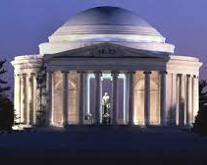
Thomas Jefferson Memorial
The Thomas Jefferson Memorial is a
memorial to the third president,
to the President of the United States and the
and the author of the Declaration of Independence.
President Franklin D. Roosevelt gave a speech at the
ceremony at the start of construction in 1938.
The monument was unveiled on the 200th anniversary of Jefferson's birth (April 13, 1943). .... The shrine features a statue of Thomas Jefferson and four of his famous quotes.

Slide 7
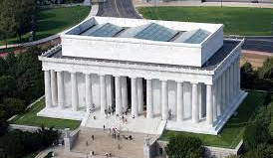
The Lincoln Memorial
The Lincoln Memorial is a monument in Washington, D.C., commemorating one of the country's most powerful leaders during the Civil War, Abraham Lincoln.
It took 4 years to build. Designed by Henry Bacon in the style of a Greek temple, the 36 columns of the building represent the states of the Union at the time of Abraham Lincoln's death. Inside are two murals, two plaques with the Gettysburg Address and the Second Inaugural Address, and a heroic statue of Lincoln.

Slide 8
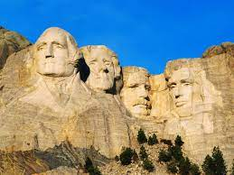
Mount Rushmore
Mount Rushmore is in the Black Hills of South Dakota. It show the faces of the four American Presidents: George Washington, Thomas Jefferson, Theodore Roosevelt and Abraham Lincoln. It is a memorial designed by an American sculptor, Gutzon Borglum. It is taller than the Great Pyramid of Egypt and is the world's greatest mountain carving.

Slide 9
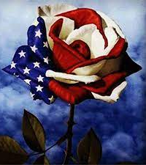
Official Flower
The rose has been named the official flower of the United States of America. The rose has been around for about 35 million years and grows naturally throughout North America. The petals and hips of the rose are edible and have been used in medicine since ancient times.

Slide 10
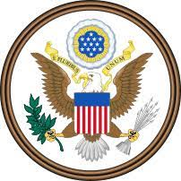
Great Seal of the United States
On July 4, 1776, Benjamin Franklin, John Adams and Thomas Jefferson were commissioned to create a seal for the 13 United States of America. The delegates to the Constitutional Convention believed that an emblem and a national coat of arms would be evidence of an independent nation and a free people with great aspirations and high hopes for the future.
Symbolically, the seal would reflect the beliefs and values that the founding fathers attached to the new nation and that they wished to pass on to their successors.
The number 13 represents the 13 original states. The olive branch and the arrows "signify the power of peace and war". The constellation of stars represents the new nation taking its place among the other sovereign states. The motto "E Pluribus Unum" expresses the unification of the 13 states.

Slide 11
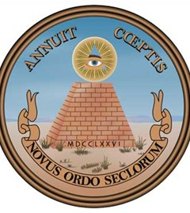
The reverse, sometimes referred to as the spiritual side of the seal, contains the 13-step pyramid with the year 1776 in Roman numerals on the base. At the summit of the pyramid is the Eye of Providence in a triangle surrounded by a Glory and above it appears the motto “Annuit Coeptis” (approved of our undertakings).

Slide 12
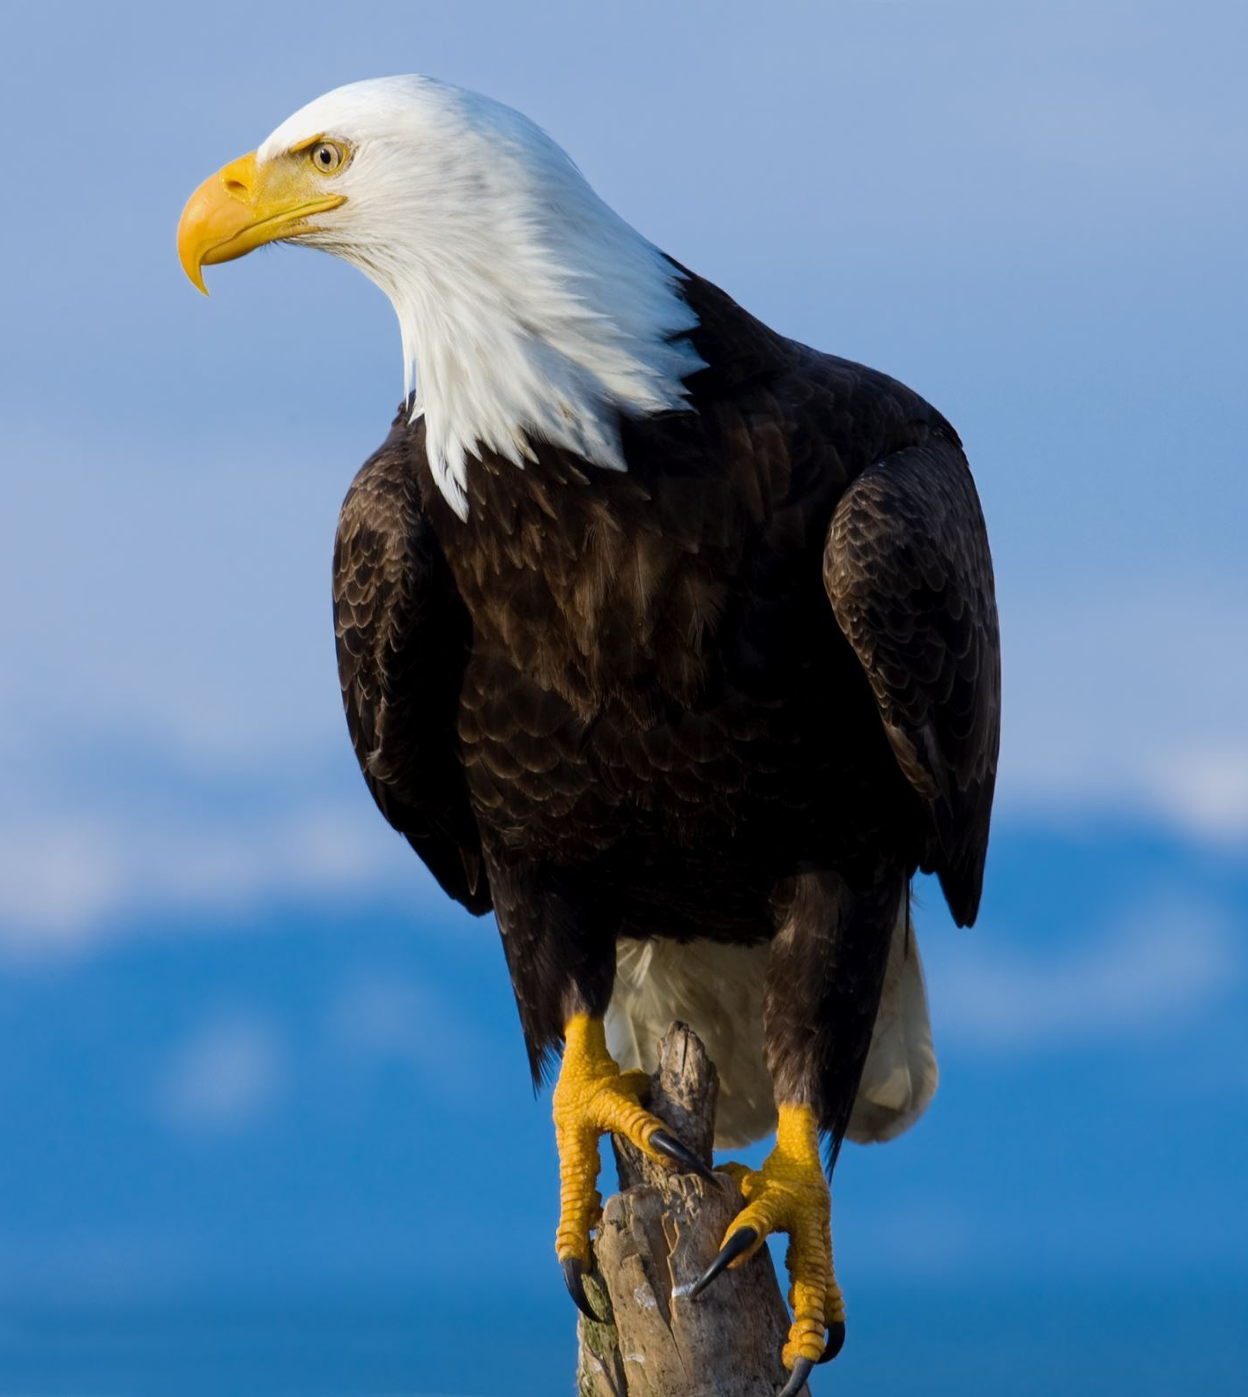
Eagle
The American bald eagle has been adopted as the official symbol of the United States of America. The bald eagle was chosen for its majestic beauty, great strength, long life and its indigenous North American ancestry. In the wild, the eagle lives for years (up to 50 years in captivity).

Slide 13
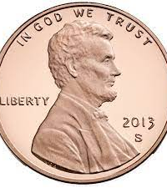
Motto
In 1956 the President approved a Joint Resolution of the 84th Congress declaring IN GOD WE TRUST the national motto of the United States. Most Americans are only familiar with the first verse of Francis Scott Key's 1814 poem The Star Spangled Banner, but the fourth verse includes: And this be our motto: "In God is our trust."
In 1956 the President approved a Joint Resolution of the 84th Congress declaring IN GOD WE TRUST the national motto of the United States. Most Americans are only familiar with the first verse of Francis Scott Key's 1814 poem The Star Spangled Banner, but the fourth verse includes: And this be our motto: "In God is our trust."

